Slide 1
a repo of one’s own
crafting repositories as a site of publication
Helen J Burgess . NC State . @polyrhetor

Slide 2
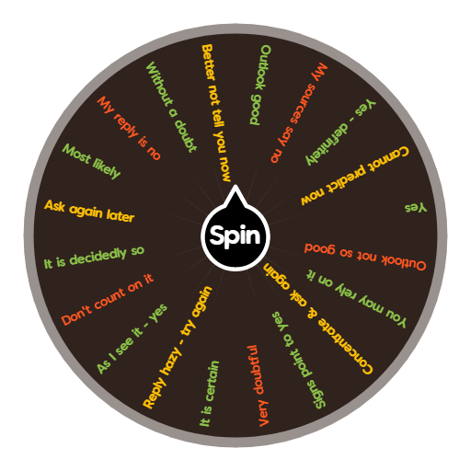
I has a thing. can I publish it?

Slide 3
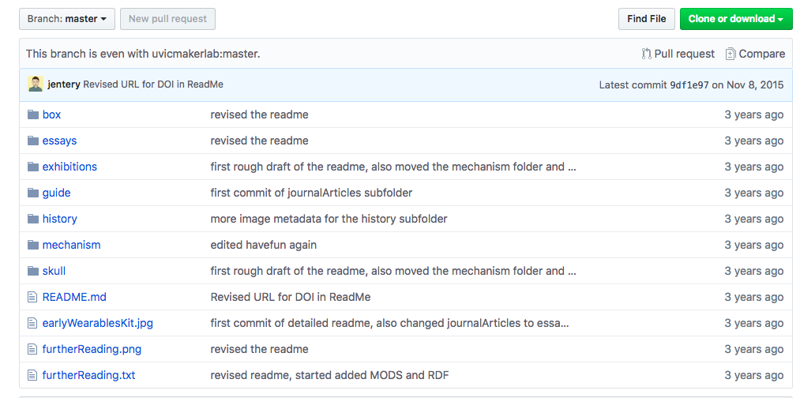
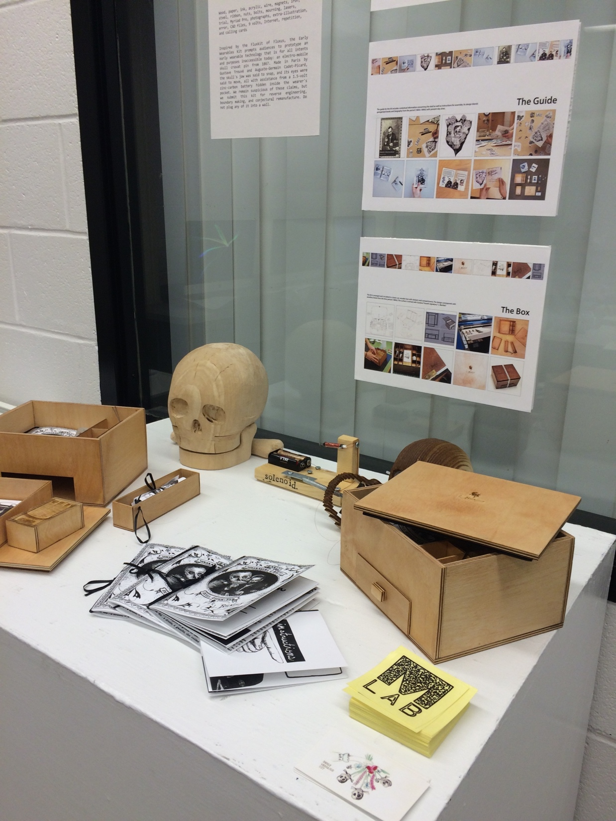
explain pull requests to me one more time

Slide 4
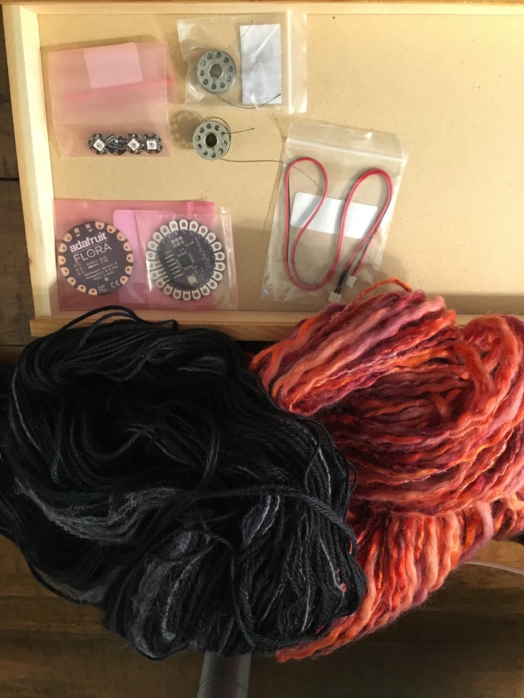
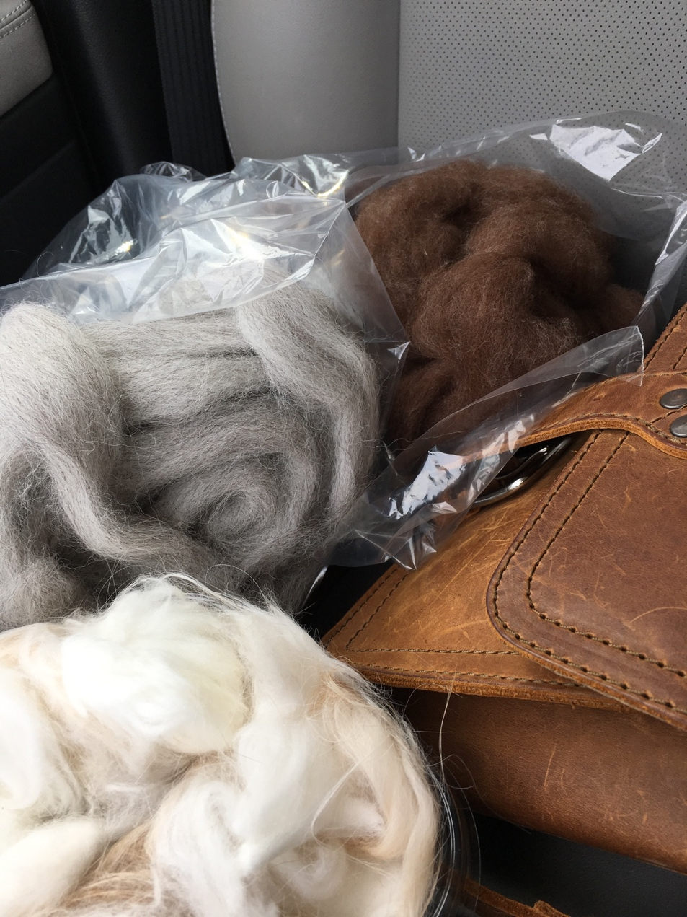
no such thing as too much yarn

Slide 5
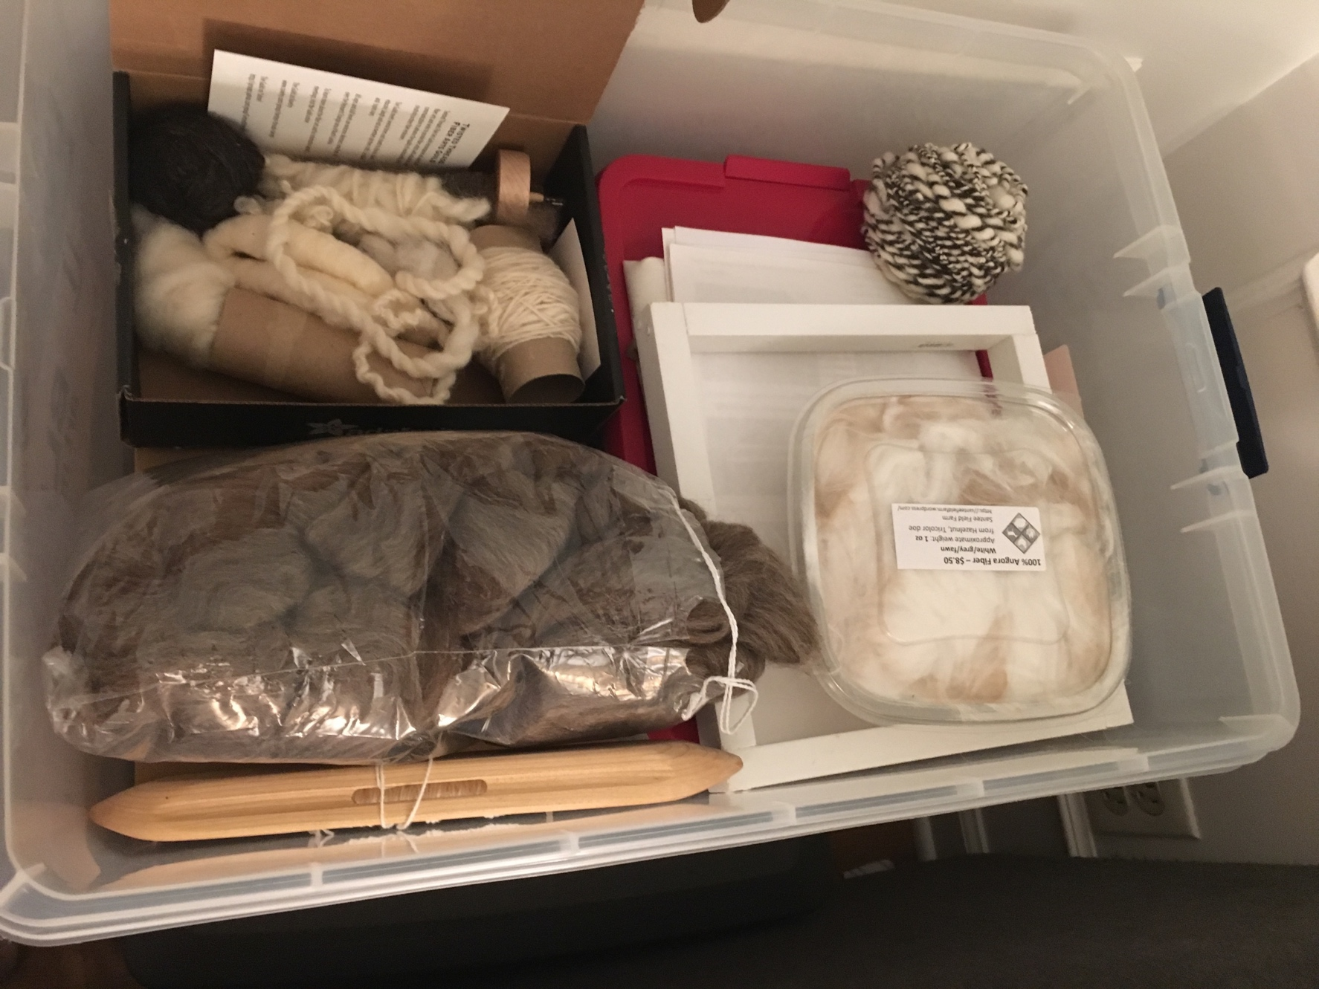
no such thing as too much fiber either

Slide 6
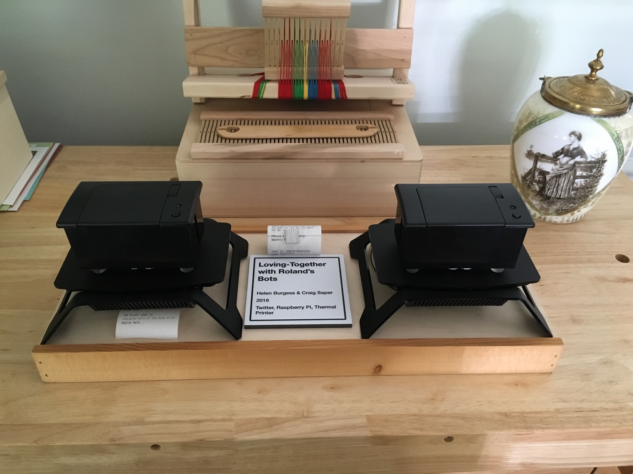
crafting transmedia repositories

Slide 7
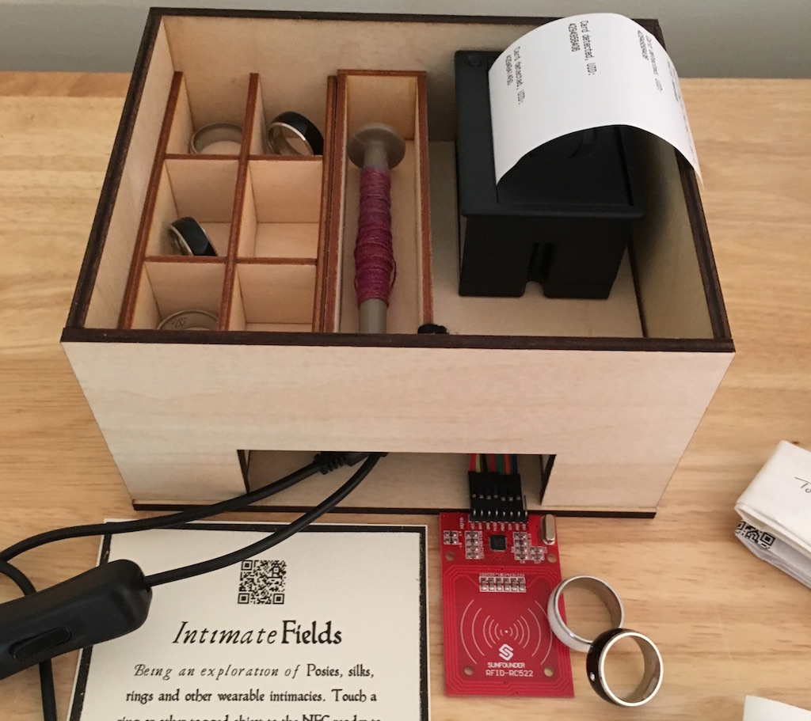
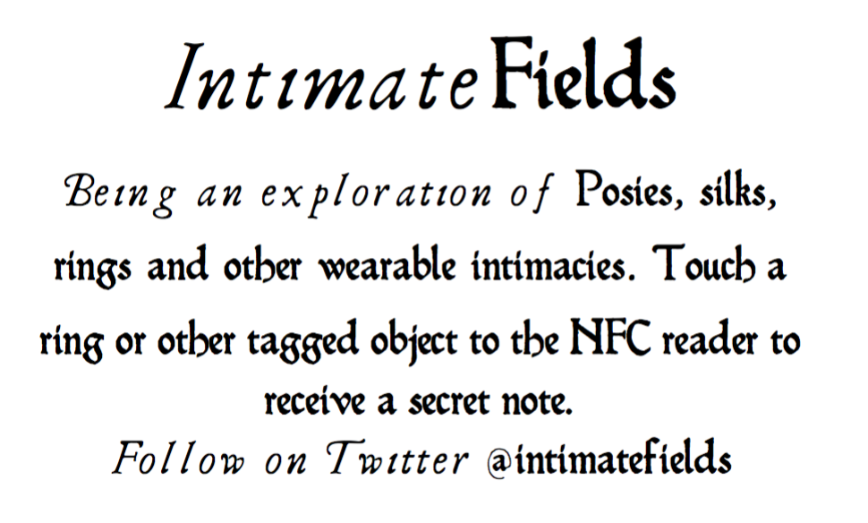
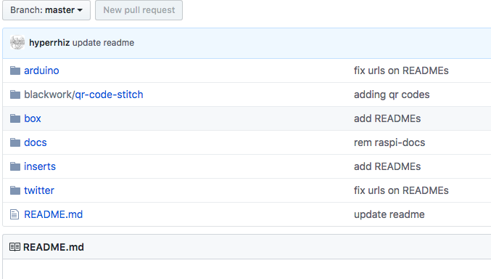
intimate fields repo

Slide 8
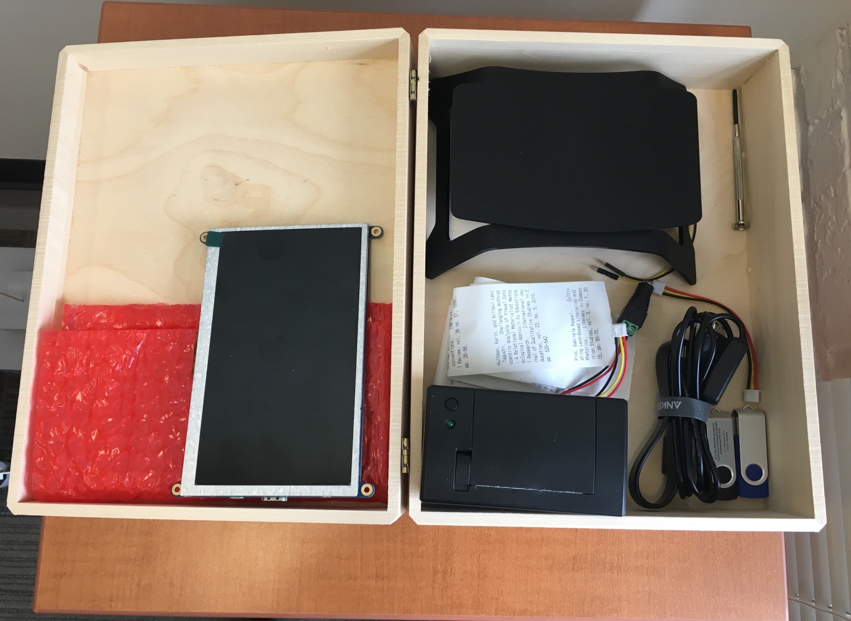
physical repo for citation station (2018)

Slide 9
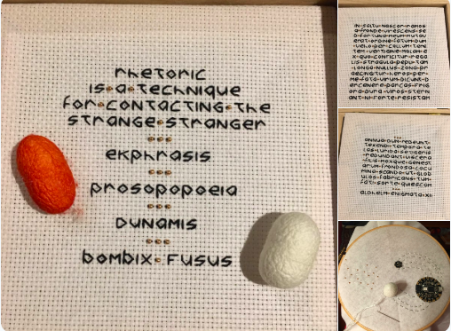
silkworm project-in-process

Slide 10
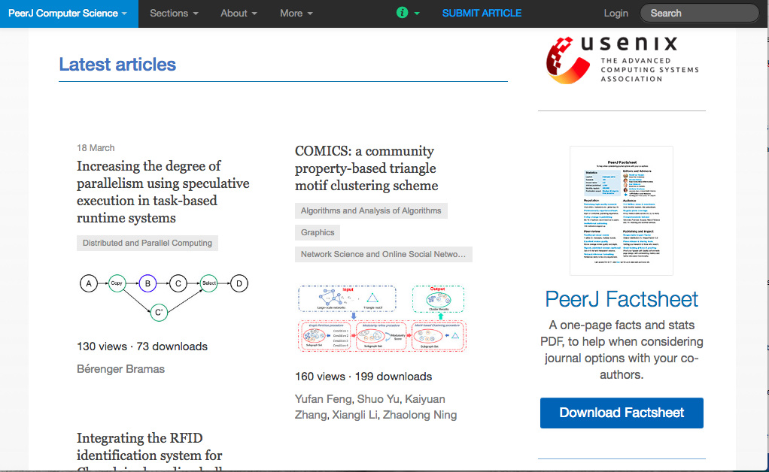
writing repositories

Slide 11
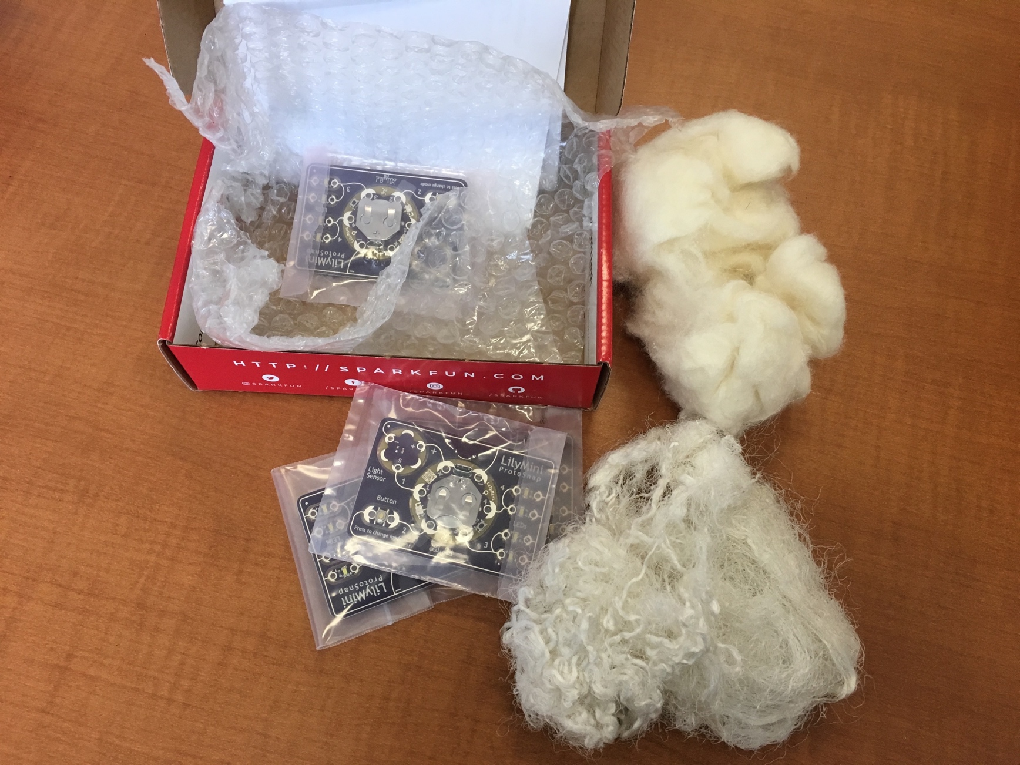
waste

Slide 12

a repo of one’s own

